Slide 1

Cognitive Labs
Lab 2: Enhancing Chatbots with Context and Sentiment

Slide 2
Objective
Extend your chatbot to provide two new functions
Advise on selecting a new mobile phone contract
Allow the user to submit a review of a phone and respond based on user sentiment
Watson Assistant extended functionality
Slots
System entities
Context variables
Watson Natural Language Understanding
Sentiment analysis
Node-RED
Slack

Slide 3
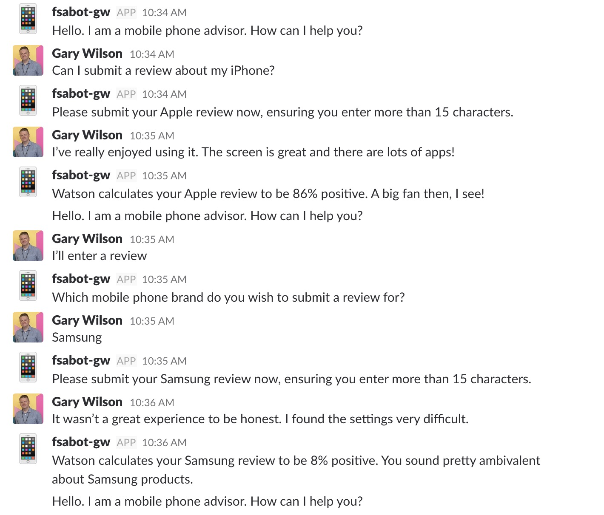
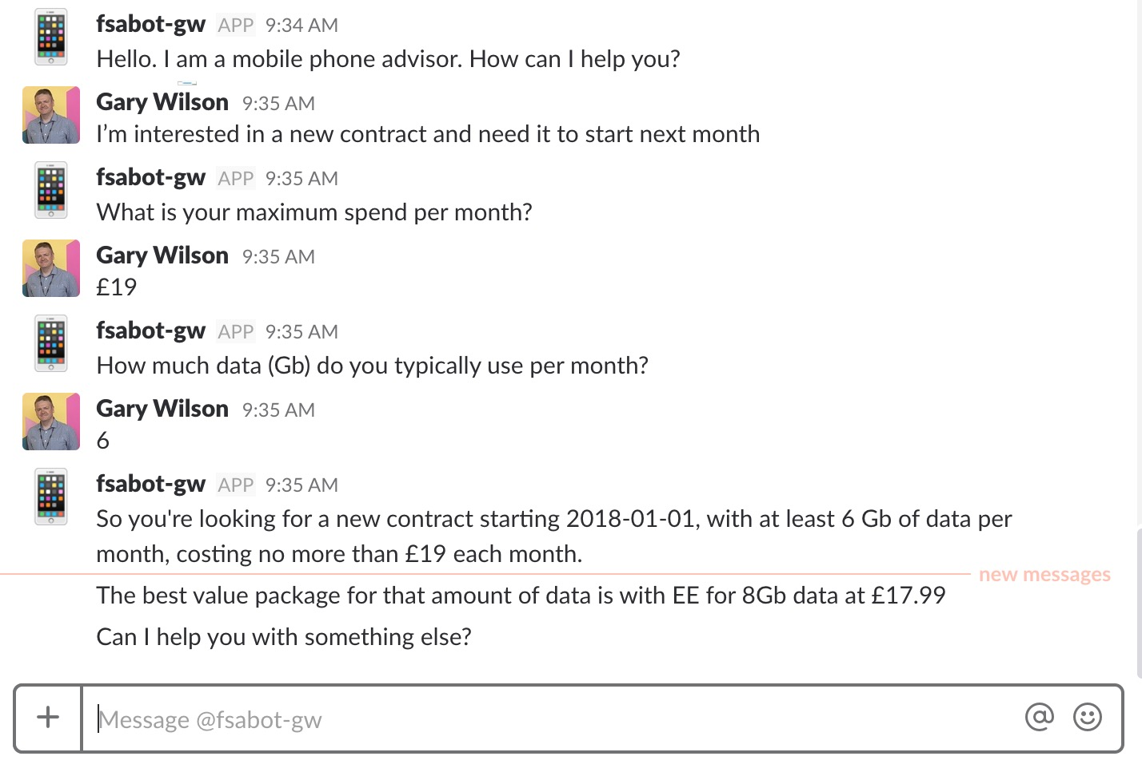
Objective

Slide 4
Agenda
Enhanced Watson Assistant functionality
extend existing dialog to cater for multiple user inputs – ‘slots’
using System Entities to capture context variables
use context variables to pass information between Watson Assistant and your Node-RED application code
Watson Natural Language Understanding (NLU)
setup an NLU instance
integrate NLU to your Node-RED app to check the sentiment of user input
modify dialog tree to utilise metadata from NLU

Slide 5
Watson Assistant: Slots
Enables developers to use prompts to gather information from users and store the information into context variables
Information to be gathered all at one time can be consolidated into one dialog node
e.g. user’s address, information needed for a reservation
Can be used to ensure dialog has all the required information and prompt the user to enter missing information
Can also be used to handle digressions while collecting information
e.g. if the user asks what are the kitchen hours when they are prompted to enter the time for their reservation, we can give the requested information, then return to the conversation

Slide 6
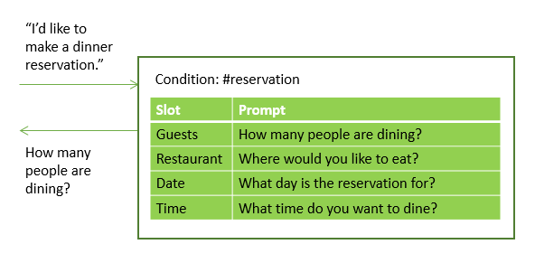
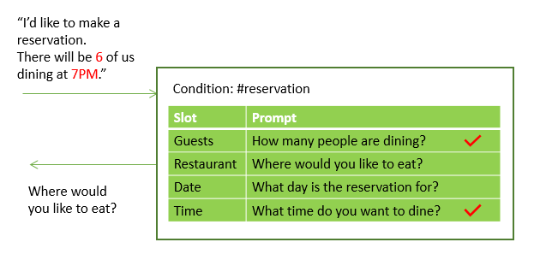
Watson Assistant: Slots

Slide 7
Watson Assistant: System Entities
System entities can be used to recognise a broad range of values for the object types they represent, for example,
@sys-number matches any numerical value, including whole numbers, decimal fractions, or even numbers written out as words
@sys-date extracts mentions such as Friday, today, or November 1, and stores the value as the corresponding inferred date as a string in the format "yyyy-MM-dd"
System entities are centrally maintained, so any updates are available automatically

Slide 8
Watson Assistant: Context Variables
Watson Assistant dialog is stateless – your application is responsible for maintaining any continuing information
But … an application can pass information to the dialog (and vice versa) using context variables
A context variable is a variable that you define in a dialog node
other nodes or application logic can subsequently set or change the value of a context variable
You can test context variables in Watson Assistant dialog node conditions to determine whether to execute a node
And you can reference and use context variables in your application logic … we’ll see this in this lab

Slide 9
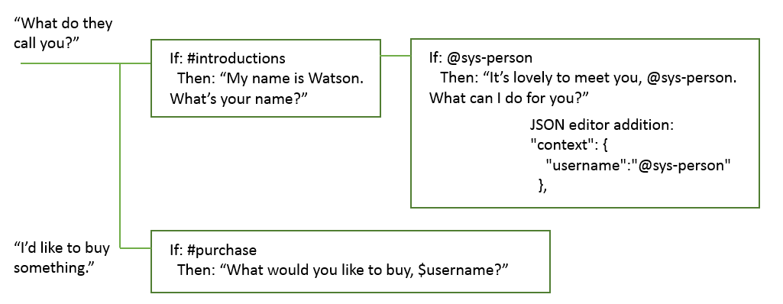
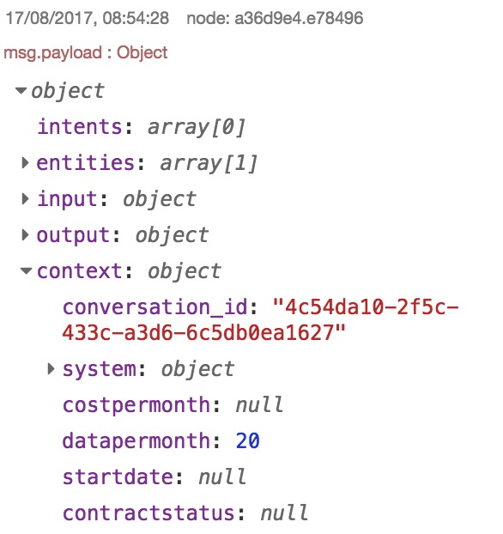
Watson Assistant: Context Variables

Slide 10
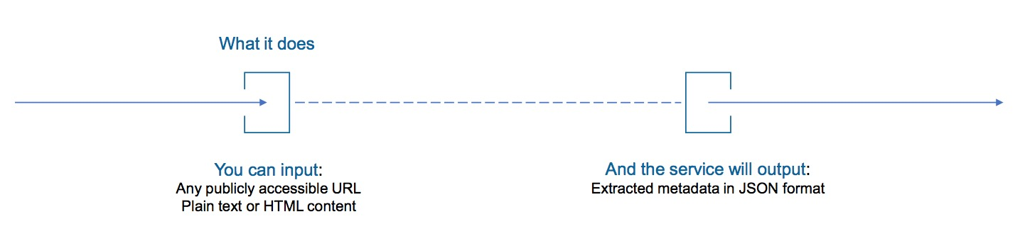
Watson Natural Language Understanding
Easy to use semantic text analysis service
Uncovers insights from structured and unstructured data
extracts metadata from content such as concepts, entities, keywords, categories, relations and semantic roles
Understand sentiment and emotion
Use cases
monitor sentiment and emotion in customer support chat transcripts
categorise blog posts - sort them based on general concepts, keywords, and entities
Full support for English, partial support for Arabic, Chinese, Dutch, French, German, Italian, Japanese, Korean, Portuguese, Russian, Spanish, Swedish

Slide 11
Watson Natural Language Understanding
Passed to NLU
Response based on sentiment
Passed to NLU
Response based on sentiment

Slide 12
Cognitive Labs
Lab 2: Enhancing Chatbots with Context and Sentiment

